Slide 1
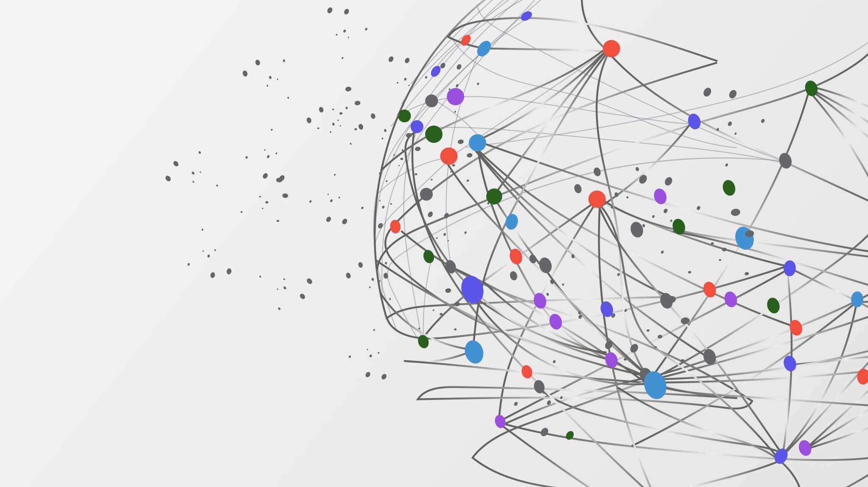
Comparative Analysis of Community Detection Algorithms
Presenter
Janvi Patel

Slide 2
Motivation
Detecting communities has grown into a fundamental, and highly relevant problem in complex network analysis with multiple applications
First, it allows to unveil the existence of a non-trivial internal network organization at coarse grain level
Second, it helps to better understand the properties of dynamic processes taking place in a network
Understanding community structure in social media is critical due to its broad applications such as friend recommendations, link predictions and collaborative filtering
Many community detection algorithms have been developed to uncover the mesoscopic properties of complex networks
However how good an algorithm is, in terms of accuracy and computing time, remains still open in the absence of ground truth labels for the underlying communities as is seen in most real-world situations
Testing on real networks is necessary, but also limited: the considered real networks are usually small, the actual underlying communities are generally not defined objectively, and it is not possible to control their properties generating artificial networks makes it possible to overcome these limitations

Slide 3
Related Work
In [1], different community detection algorithms were implemented leveraging the igraph library which is then investigated and ranked according to their performances in a set of different scenarios. The algorithms are evaluated by ranking the modularity measures Q and the running times t ratio
Lancichinetti and Fortunato [2] comapared the performance of 12 different clustering algorithms using the GN and the LFR benchmarks. The authors focus on mixing parameters to perform comparative analysis for different values of network sizes
Orman and Labatut [3] compared five community detection algorithms to study the behavior of mixing parameters and evaluate the performance of community detection algorithms concluding that walktrap and multilevel methods perform better

Slide 4
Methodology
Employ the Real-world network and Synthetically generated network to evaluate 5 state-of-the-art algorithms
Quantify the accuracy using complementary measures and algorithms computing time
Hypothetical Case Studies:
First: To determine which is the most suited algorithm in most circumstances based on observable properties of the network under consideration while detecting communities in real-world network
Second: Analyze how communities are formed as the network grows and use different parameter as an easily measurable indicator of finding the ranges of reliability of the different algorithms
Algorithms
Multilevel (Optimization based)
Infomap (Optimization based)
Fastgreedy (Optimization based)
Label Propagation (Agglomerative)
Walktrap (Agglomerative)
Modularity
Conductance
Coverge
Execution Time
Metrics

Slide 5
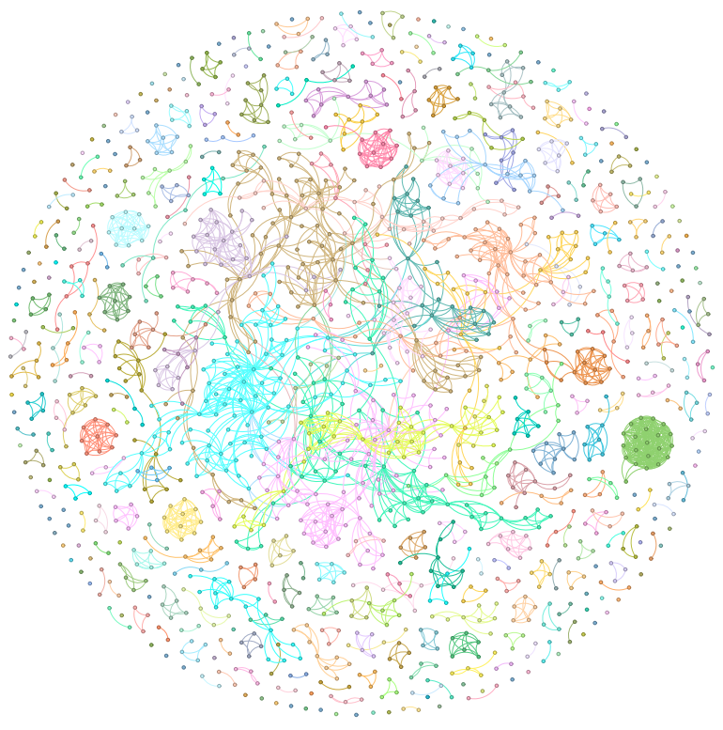
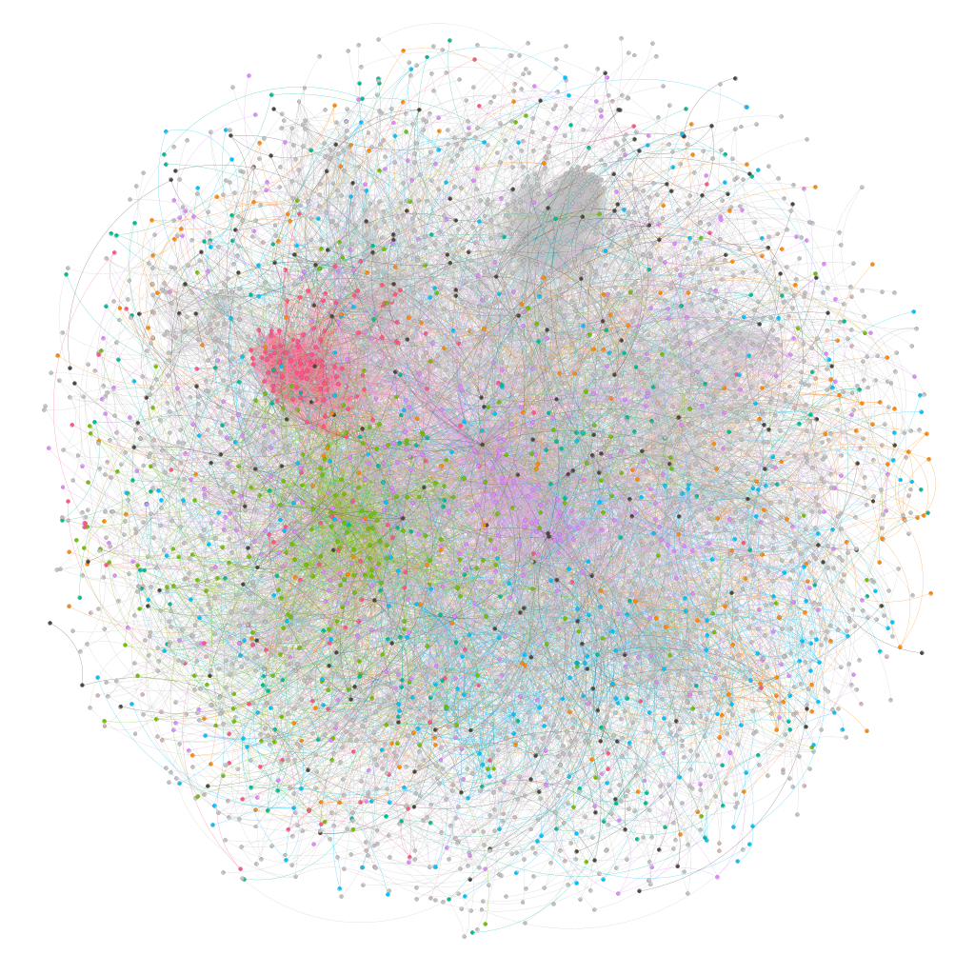
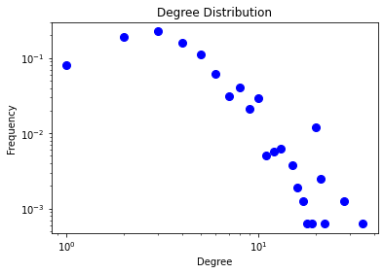
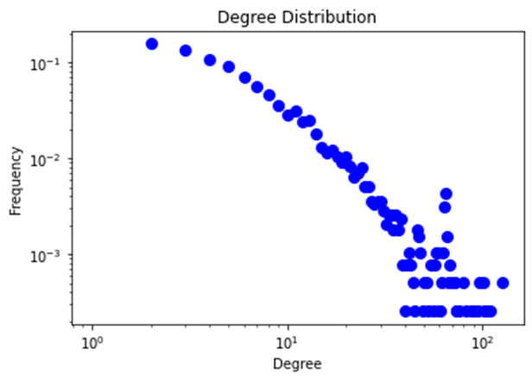
Hypothesis I: How different algorithms behave on real-world networks
NetScience Network: A network of authors on network science, linked if they have published an article together
Nodes: 1589
Edges: 2742
Facebook Network: A network representing blue verified Facebook page networks of TV shows. Nodes represent the pages and edges are mutual likes among them
Nodes: 3892
Edges: 17,262

Slide 6
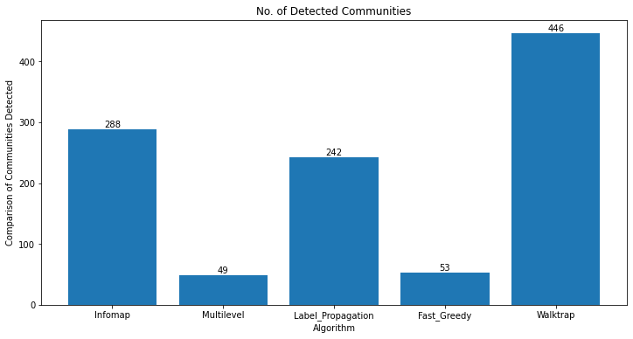
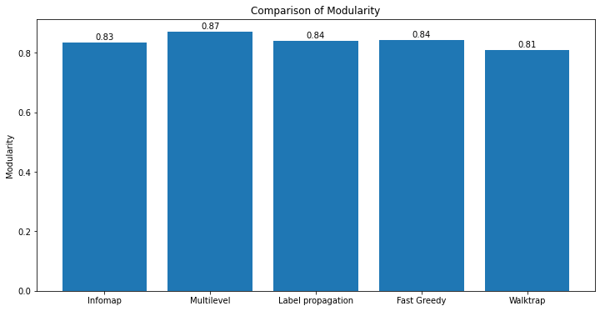
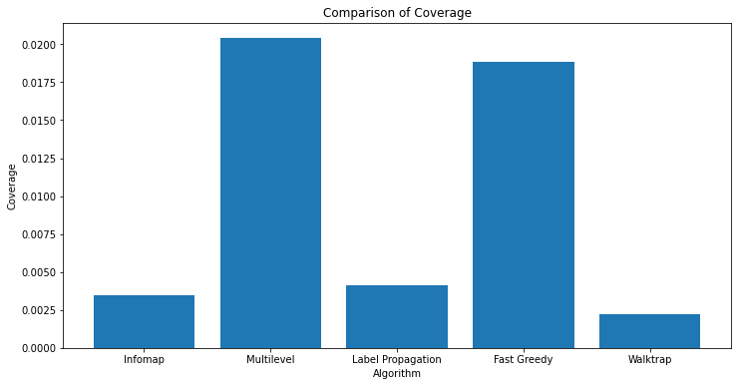
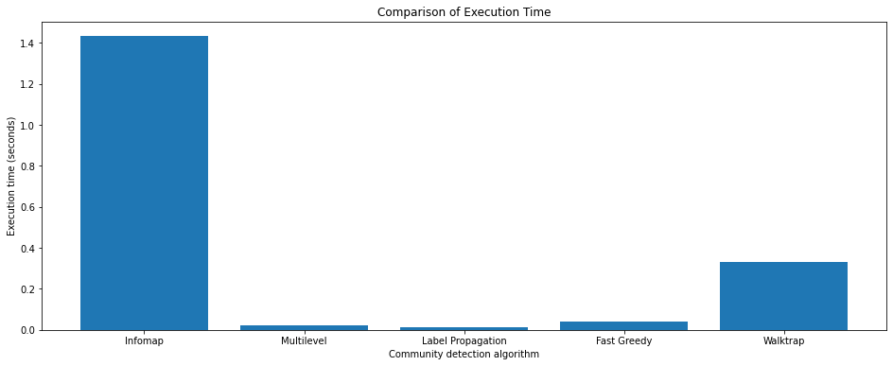
Results: Facebook Network
Desired:
High Modularity = Distinct Communities
High Coverage = Larger proportion of nodes are correctly assigned
Notes:
Modularity: Measures the extent to which nodes within a community are more densely connected to each other than the nodes in other communities
High Modularity = Distinct Communities
As modularity increases, no of communities decreases
Coverage: How well a algorithm is able to assign nodes to the correct communities
High Coverage = Larger proportion of noes are correctly assigned

Slide 7
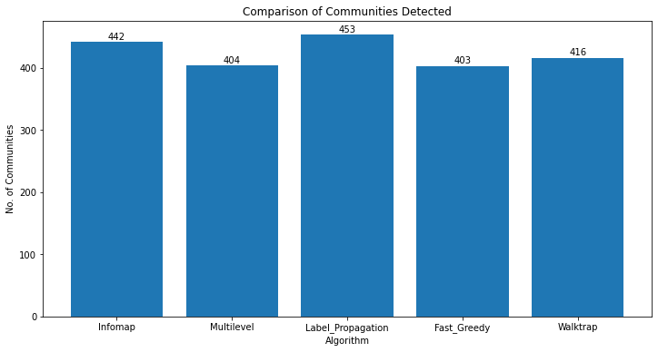
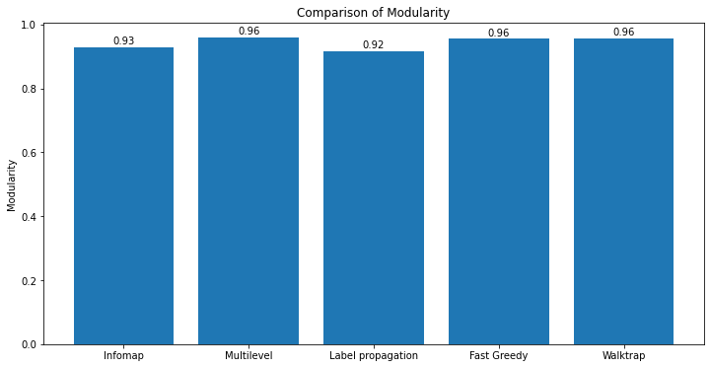
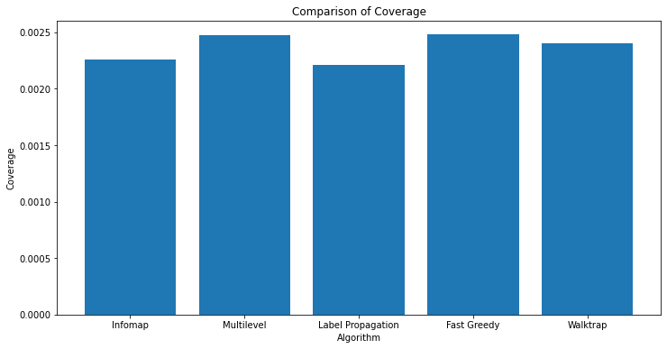
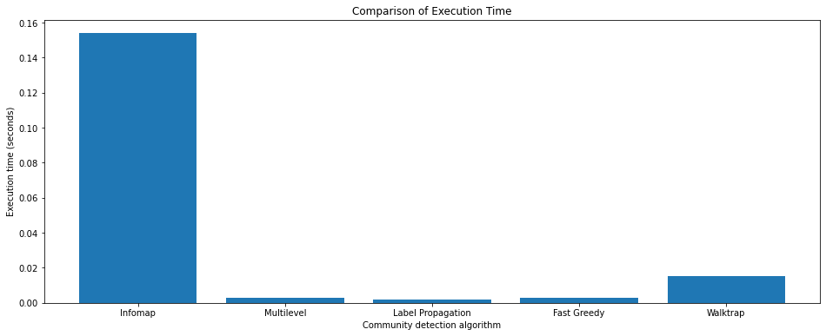
Results: NetScience Network
Notes:
Overall, Infomap's time-consuming nature is due to its optimization-based approach, iterative nature, stochastic exploration, and hierarchical structure

Slide 8
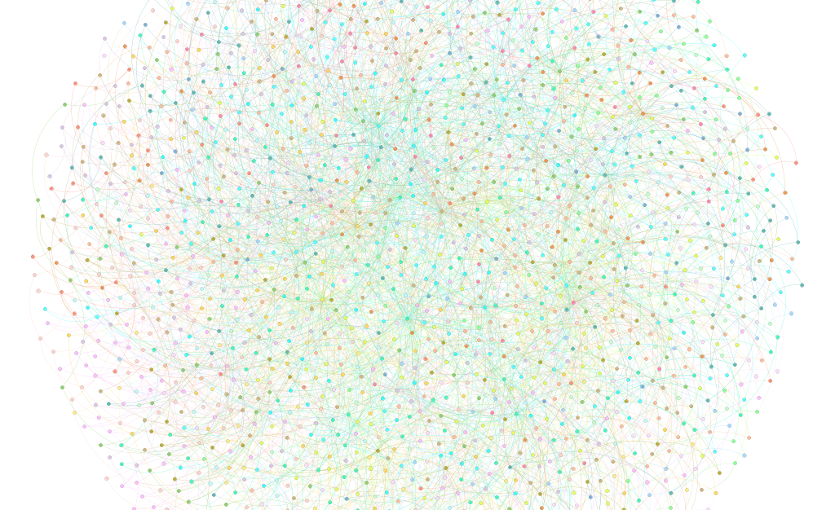
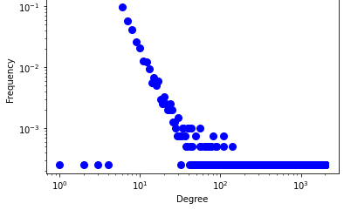
Hypothesis II: How community detection algorithms behave overgrowth of the network
Generated a random graph using Barabási–Albert preferential attachment with 2000 nodes
Parameter setting for m = 2, m = 4 to check the performance

Slide 9
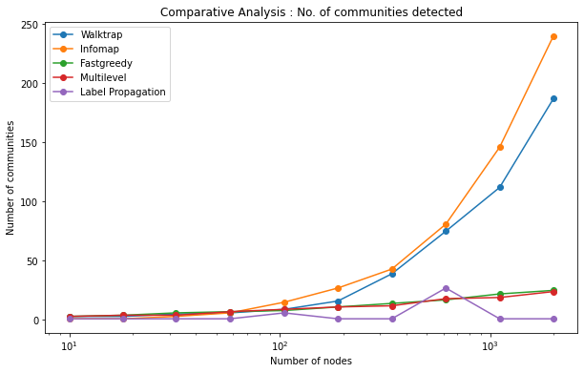
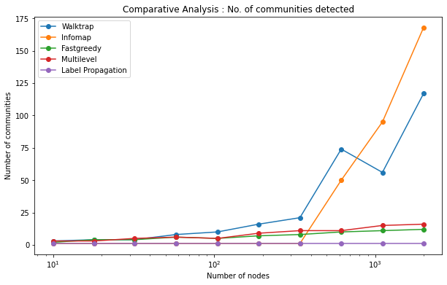
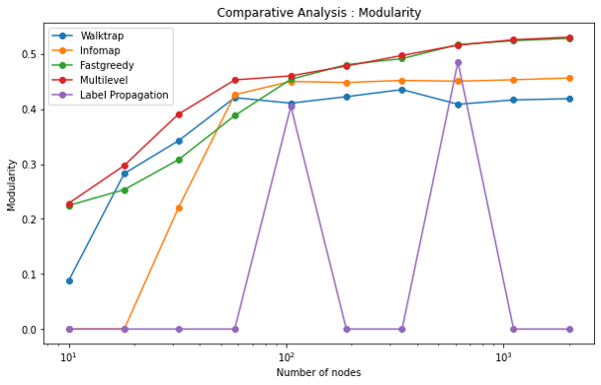
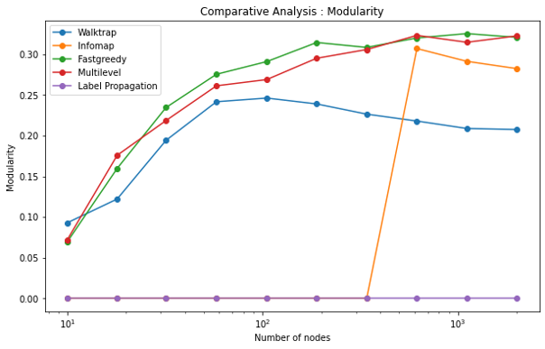
Results
Desired:
High Modularity = Distinct Communities
High Coverage = Larger proportion of nodes are correctly assigned
M = 2
M = 4
Notes:
As no of nodes and edges increases, the no of communities increases meaning hubs are formed with many connections and many poorly connected nodes

Slide 10
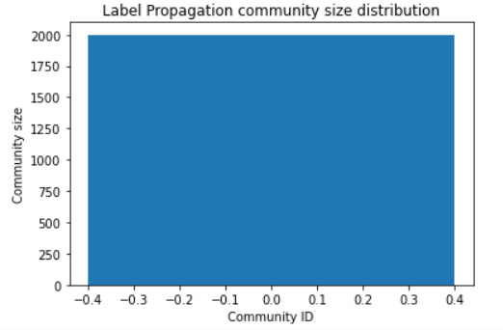
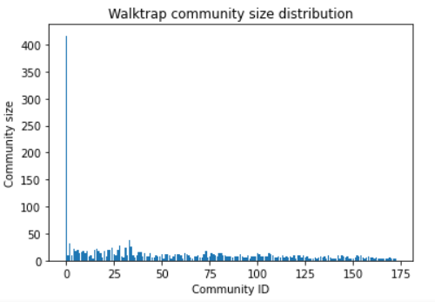
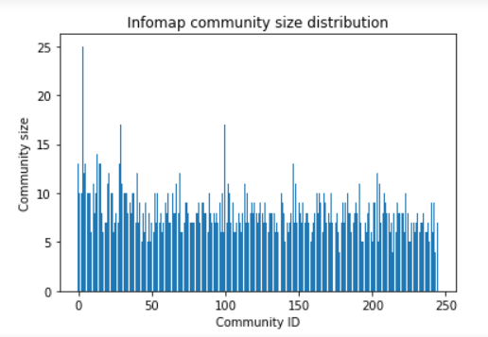
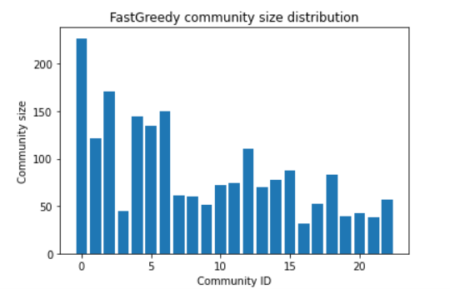
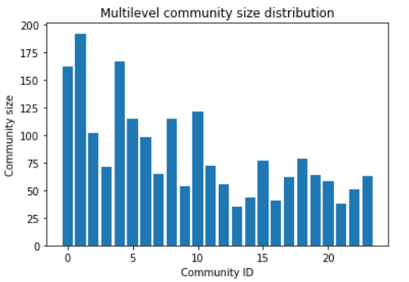
Notes:
Fastgreedy and Multilevel were able to efficiently identify hubs.
Whereas walktrap and infomap discovered many isolated nodes and that’s why their modularity is low and no of communities is high
Label propagation performed worst

Slide 11
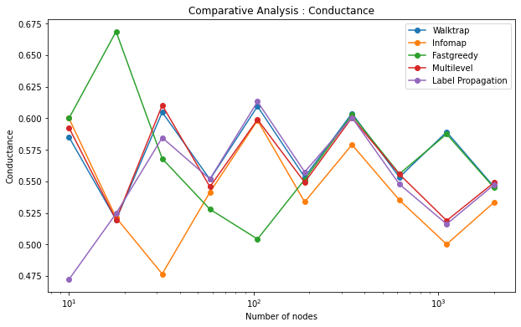
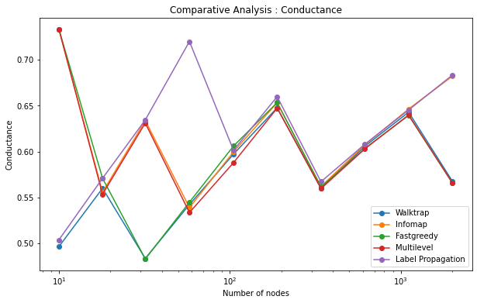
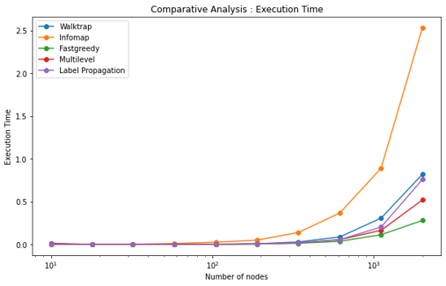
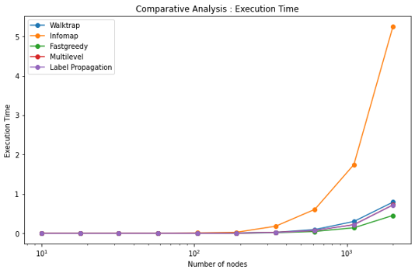
Results:
Desired: Low Conductance = Well defined communities
M = 2
M = 4
Notes:
In the early stages of network growth, when the number of nodes is small, the conductance of communities tends to be high. This is because the communities are likely to be tightly connected and have relatively few edges connecting them to the rest of the network. As the network grows and more nodes and edges are added, the conductance of communities decrease.

Slide 12
Discussion
In this study I have performed a comparative analysis of the accuracy and computing time of five different community detection algorithms available in the “igraph” package
Each algorithm has been tested on a set of Real-world graphs and synthetically generated graph
Multilevel, walktrap, and fastgreedy gave better results compared to other algorithms
The modularity of a network increases, no of communities decreases because high modularity indicates a strong division of a network into distinct communities
A higher value of m leads to more connections with fewer communities whereas lower value of m results in a sparse network with more distinct communities
These findings are an important contribution for aiding researchers to select or discard algorithms in their own experiments using igraph library

Slide 13

Future Scope
Test the proposed approach to analyze the random networks
Use of different evaluation metric such as NMI score
Increase the network size

Slide 14

References
F. Berardo de Sousa and L. Zhao, "Evaluating and Comparing the IGraph Community Detection Algorithms," 2014 Brazilian Conference on Intelligent Systems, Sao Paulo, Brazil, 2014, pp. 408-413, doi: 10.1109/BRACIS.2014.79.
A. Lancichinetti and S. Fortunato, "Community detection algorithms: A comparative analysis", Phys. Rev. E Stat. Phys. Plasmas Fluids Relat. Interdiscip. Top., vol. 80, no. 5, pp. 056117, 2009.
Orman, G. K. & Labatut, V. A comparison of community detection algorithms on artificial networks. In Discovery Science 242–256 (Springer, 2009).
J. Leskovec, K. J. Lang and M. Mahoney, "Empirical comparison of algorithms for network community detection", Proc. 19th Int. Conf. World Wide Web, pp. 631-640, 2010.
Dao, V., Bothorel, C., & Lenca, P. (2020). Community structure: A comparative evaluation of community detection methods. Network Science, 8(1), 1-41. doi:10.1017/nws.2019.59

